Slide 1
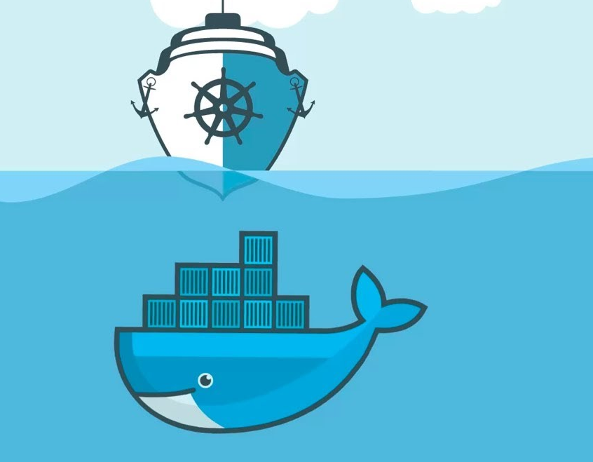
Understand Kubernetes

Slide 2
Kubernetes defined (Since 2014, by Google):
Kubernetes, also known as k8s or kube, is an open-source container orchestration platform for scheduling and automating the deployment, management and scaling of containerized applications.
As containers proliferated, today, an organization might have hundreds or thousands of them. Operations teams are needed to schedule and automate container deployment, networking, scalability, and availability. Enter container orchestration.
In a Cloud Native Computing Foundation (CNCF) report, Kubernetes is the second largest open-source project in the world (after Linux) and the primary container orchestration tool for 71% of Fortune 100 companies.
In 2018, Kubernetes was the CNCF’s first graduate project, becoming one of the fastest-growing open-source projects in history. While other container orchestration options, most notably Docker Swarm and Apache Mesos, gained some traction early on, Kubernetes quickly became the most widely adopted.

Slide 3
Kubernetes schedules and automates container-related tasks throughout the application lifecycle:
Deployment: Deploy a specified number of containers to a specified host and keep them running in a desired state.
Rollouts: A rollout is a change to a deployment. Kubernetes lets you initiate, pause, resume, or roll back rollouts.
Service discovery: Kubernetes can automatically expose a container to the internet or to other containers by using a domain name system (DNS) name or IP address.
Storage provisioning: Set Kubernetes to mount persistent local or cloud storage for your containers as needed.
Load balancing: Based on CPU usage or custom metrics, Kubernetes load balancing can distribute the workload across the network to maintain performance and stability.
Autoscaling: When traffic spikes, Kubernetes autoscaling can spin up new clusters as needed to handle the additional workload.
Self-healing for high availability: When a container fails, Kubernetes can restart or replace it automatically to prevent downtime. It can also take down containers that don’t meet your health check requirements.

Slide 4
Kubernetes architecture and components:
Ingress: Acts like the domain and the bundle of the services.
Service: Permanent IP address. Lifecycle of pod and service not connected, so even if the pod dies, the service and its IP address will stay.
Pod: the smallest unit of K8S and is ephemeral. Usually meant to run one app container.
Service
My APP [Container]
IP
K8S offers out of the box a virtual network which means that each pod gets its own IP address not the container.
DB [container]
But the pod is ephemeral
Service
IP
NODE

Slide 5
Kubernetes architecture and components:
Ingress: Acts like the domain and the bundle of the services.
K8S doesn’t manage data persistence
Config Map
Service
Config Map: External configuration of your app.
My APP [Container]
IP
Secret
Secret: Used to store secret data like DB credentials. Base64 encoded
Volumes: attaches a physical storage on a hard drive to your pod and that storage can on local or remote.
DB [container]
Service
IP
Data
NODE

Slide 6
Kubernetes architecture and components:
Deployment: define blueprints for pods and make any number of replica.
The replica is connected to the same service.
Service has two functionalities:
Permanent IP
Load balancer
Config Map
Config Map
My APP [Container]
Service
My APP [Container]
IP
IP
Database can’t be replicated vid deployment; you’re accessing the same shared data.
Secret
Secret
Statefulset
DB [container]
DB [container]
Service
IP
IP
Data
Data
NODE 2
NODE 1
Volume

Slide 7
Kubernetes architecture explained (Worker Process):
Each node has multiple pods on it besides DB
Pod
Pod
Three processes must be installed on every node to schedule and manage those pods
Pod
Container Runtime Process
Kube Proxy forwards the requests and makes sure that the communication also works in a performant way, with low overhead
DB [container]
Kubelet process interacts with both the container and node, it starts the pod with a container inside
Worker/Server/Node

Slide 8
Kubernetes architecture explained (Master Process):
API Server
API/Cluster gateway and responsible for authentication
Scheduler
Schedule requests based on resource allocation.
Controller Manager
Fault partition/tolerance and detects cluster state.
etcd
Cluster brain. Stores the cluster state; everything depends on its data.
Master
Pod
Pod
Pod
Pod
Pod
Pod
DB [container]
DB [container]
30%
60%

Slide 9
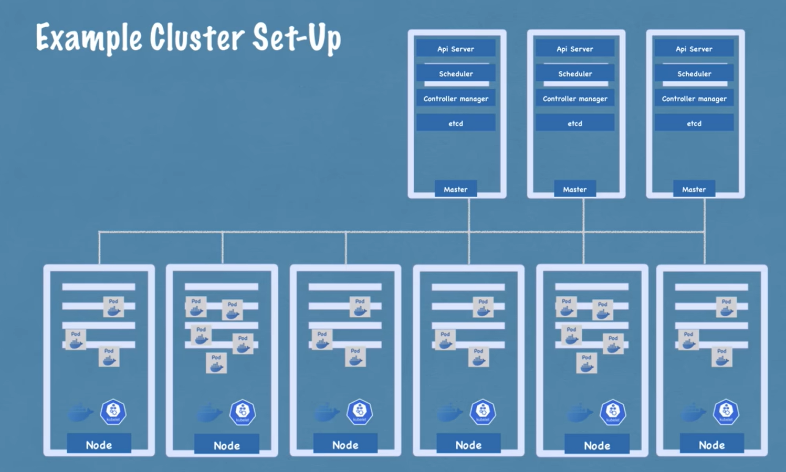
1) Get new bare server.
2) Install all master/worker processes.
3) Add it to the cluster.

Slide 10
Minikube and Kubectl

Slide 11

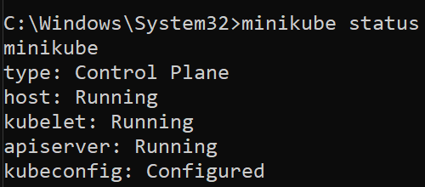
Minikube enables master and node processes to run on one machine to test a local cluster setup. It creates a virtual box.
Kubectl is a command-line tool for a K8S cluster to create, delete, and configure components. It also works with cloud cluster.
Create and start the cluster, but make sure that the docker engine is running.
Get status of the nodes
Get minikube status

Slide 12

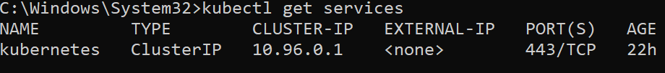
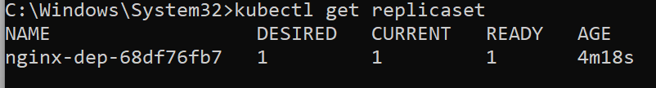
Get the status of different components, create and edit pods:
Deployment is the blueprint for creating pods. It’s an abstraction layer underneath the pod is created
Deployment name
It will open an auto-generated configuration file with default values that you could change.

Slide 13
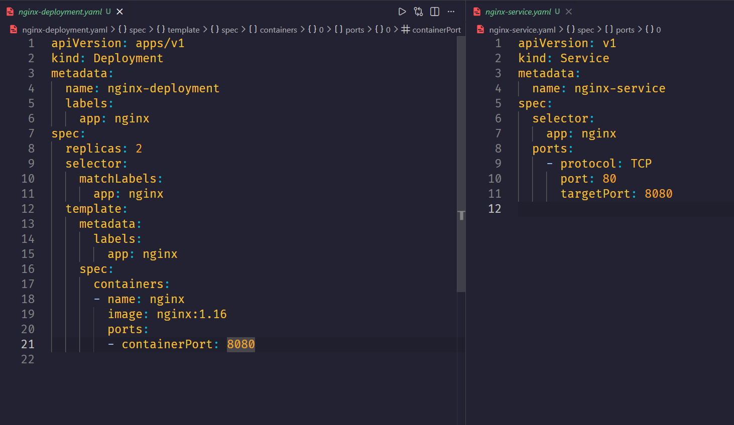
Configuration files:
Kubectl apply –f nginx-deployment.yaml
Kubectl apply –f nginx-service.yaml
Kubectl describe service Service_Name
Kubectl apply get pod –o wide

Slide 14
References:
https://learn.microsoft.com/en-us/azure/architecture/guide/architecture-styles/microservices
https://cloud.google.com/learn/what-is-microservices-architecture
https://www.ibm.com/think/topics/microservices
https://www.ibm.com/think/topics/rest-apis
https://www.ibm.com/think/topics/api-gateway
https://www.ibm.com/think/topics/kubernetes
https://www.youtube.com/watch?v=X48VuDVv0do

Slide 15
THANK YOU

